Slide 1

Student Performance Analysis
A Python Project by Debasmita Paul

Slide 2

Data Analysis Project Steps
Create a Problem Statement.
Identify the data you want to analyze.
Explore and Clean the data.
Analyze the data to get useful insights.
Present the data in terms of reports or dashboards using visualization.

Slide 3
Business Problem
Educational institutions often face challenges in identifying factors that influence student success. By analyzing student performance data, we aim to uncover patterns and insights that can guide schools in making informed decisions about teaching strategies, student support, and resource allocation.

Slide 4
Objective of the Analysis
To analyze student performance data to identify trends and key factors affecting scores in Math, Reading, and Writing.
To understand the impact of demographic and socioeconomic variables (gender, parental education, marital status, ethnic group, etc.) on student achievement.
To provide actionable insights and recommendations for educators and stakeholders to enhance learning outcomes.

Slide 5
Research Questions
Does gender affect student performance in different subjects?
How does parental education influence student scores?
Does parents' marital status impact student achievement?
How does ethnic group distribution relate to performance?
Does participation in sports practice impact student academic performance?
Are there outliers indicating students needing attention?

Slide 6
Dataset Overview
Gender: Gender of the student (male/female)
EthnicGroup: Ethnic group of the student (group A to E)
ParentEduc: Parent(s) education background (from some_highschool to master's degree)
LunchType: School lunch type (standard or free/reduced)
TestPrep: Test preparation course followed (completed or none)
ParentMaritalStatus: Parent(s) marital status (married/single/widowed/divorced)
PracticeSport: How often the student parctice sport (never/sometimes/regularly))
IsFirstChild: If the child is first child in the family or not (yes/no)
NrSiblings: Number of siblings the student has (0 to 7)
TransportMeans: Means of transport to school (schoolbus/private)
WklyStudyHours: Weekly self-study hours(less that 5hrs; between 5 and 10hrs; more than 10hrs)
MathScore: math test score(0-100)
ReadingScore: reading test score(0-100)
WritingScore: writing test score(0-100)

Slide 7
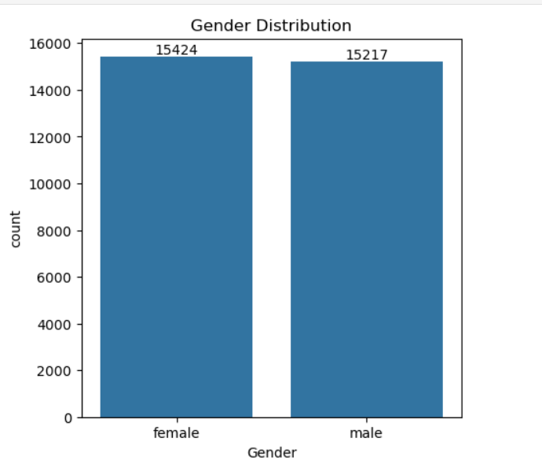
Analysis and Findings
Gender Distribution of Students
The bar chart shows a higher number of female students compared to male students. This demographic detail is important because gender can influence learning styles, subject preferences, and academic support needs. A higher female student population may also reflect broader enrollment trends or specific school demographics.

Slide 8
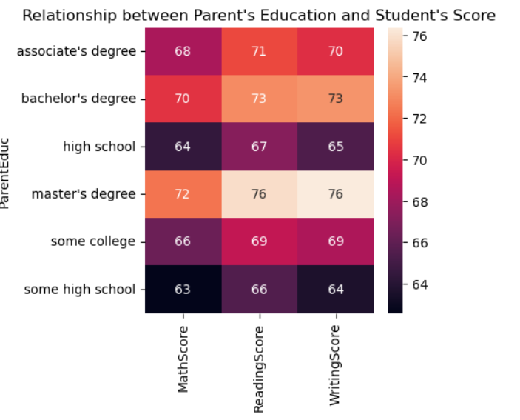
Impact of Parental Education on Scores
The heatmap illustrates that students whose parents have higher education levels (college degree or higher) tend to score significantly better in Math, Reading, and Writing. This suggests that parental educational background plays a critical role in shaping a student's academic environment and success.

Slide 9
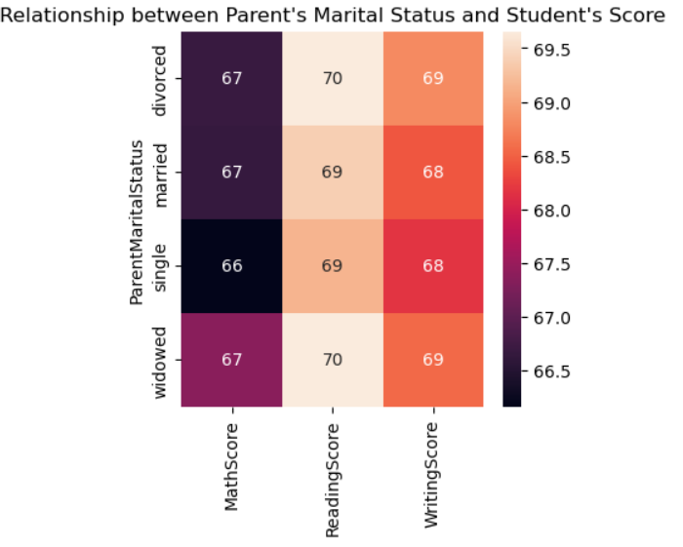
Parental Marital Status Affect Students' Scores
This visualization compares students’ average scores based on whether their parents are married or single. The analysis shows minimal differences in performance between these two groups. This suggests that parental marital status does not have a significant impact on students' academic success.

Slide 10
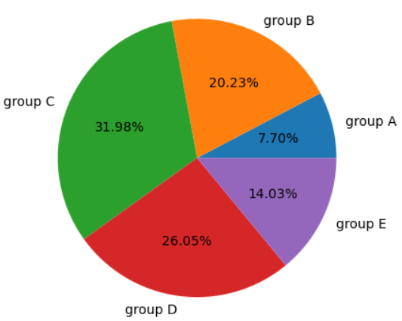
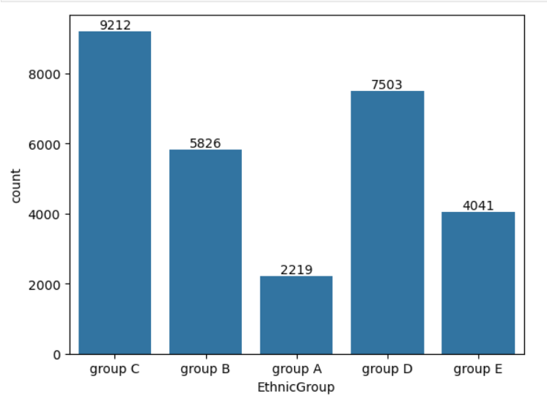
Ethnic Group Distribution Among Students
This visualization shows the distribution of students across different ethnic groups. Some ethnic groups have higher representation. Understanding this distribution helps in tailoring inclusive educational strategies that address the needs of diverse student populations. Schools can foster inclusivity by recognizing and supporting cultural diversity.

Slide 11
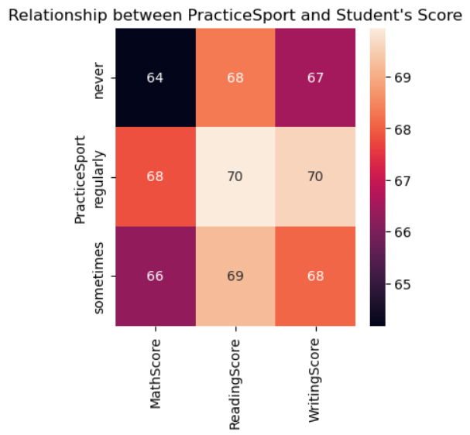
Impact of Sports Practice on Student Performance
Students who regularly participate in sports tend to have slightly higher average scores across all subjects. This suggests a positive relationship between physical activity and academic performance, possibly due to improved focus, discipline, and time management from sports involvement.

Slide 12
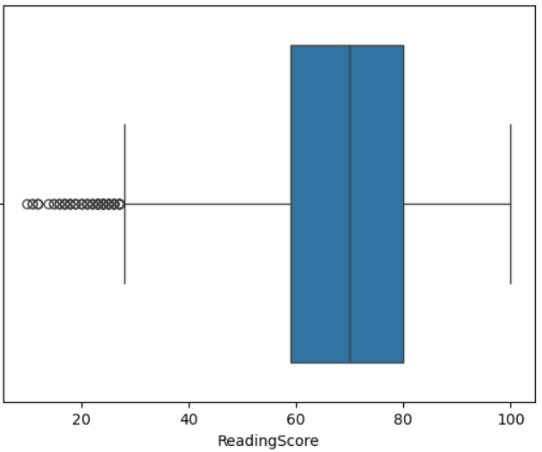
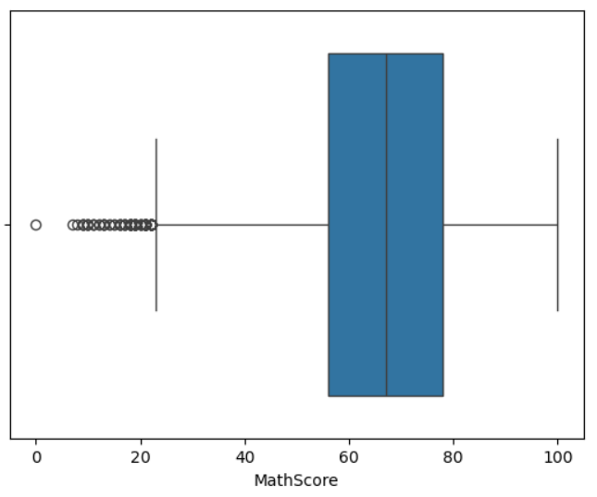
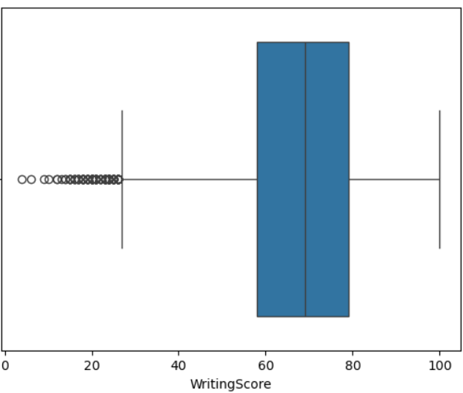
Outlier Analysis
The boxplots reveal the distribution of scores in each subject and highlight the presence of outliers. There are students who perform exceptionally well (high outliers) and others who perform significantly below the average (low outliers). These outliers are important for individualized intervention: High achievers may benefit from advanced learning programs or gifted student initiatives. Low performers may need additional academic support, tutoring, or mentoring programs.

Slide 13
Conclusions
The data shows a higher number of female students than male students. While gender alone doesn't fully explain performance differences, tailored strategies may help address specific learning needs and encourage balanced participation.
Students whose parents have higher education levels consistently perform better in Math, Reading, and Writing. This highlights the importance of parental involvement and educational background in supporting student learning outcomes.
There is minimal difference in academic performance between students from single-parent and married households. This suggests that factors other than marital status (like parental support and engagement) may play a more critical role in student success.
Students come from a range of ethnic backgrounds, with Group C representing the largest proportion. Although the distribution is diverse, no major performance gaps were observed solely based on ethnicity, but an inclusive approach to teaching remains essential.
Sports practice has a positive impact on student performance, although it's not as strong as other factors like parental education or study time. Encouraging sports can contribute to a balanced student life and better academic outcomes.
The analysis identified both high-performing and underperforming students. This suggests the need for personalized interventions—providing extra support for those falling behind and enrichment opportunities for top achievers.

Slide 14
Recommendations
Encourage parental involvement, especially for families where parents have lower education levels.
Promote balanced study hours and extracurricular activities (sports participation) for better student well-being and academic results.
Provide extra support to students from underperforming ethnic groups or single-parent families.
Investigate and support students who are outliers—whether they need advanced programs or additional resources.
Implement targeted programs focusing on Math improvement for male students and holistic development for all.

Slide 15
THANK YOU

